Slide 1
Text Generation and Language Translation

Slide 2
Text Generation
Text generation involves creating human-like text based on input data, using algorithms and models to predict and generate coherent sequences of words.
Importance in NLP:
Text generation is a key area in NLP, enabling applications like automated content creation, chatbots, and creative writing by allowing machines to generate natural language text.
Core Techniques:
Ranges from simple probabilistic models like Markov chains to advanced deep learning models like Recurrent Neural Networks (RNNs) and Transformers, each with varying capabilities to handle context and produce fluent text.
Applications:
Text generation is used in a wide range of industries, from generating personalized marketing messages to composing poetry, summarizing documents, and simulating conversations.

Slide 3
Text Generation: Techniques and Applications
Markov Chains:
Technique: Generates text by predicting the next word based on the previous word(s).
Example: "I love to" → "love to eat" (based on learned probabilities).
Use Case: Simple chatbot responses, auto-completion.
Recurrent Neural Networks (RNNs):
Technique: Uses a sequence of words to predict the next word while retaining memory of previous inputs.
Example: Generating a paragraph that continues a given sentence.
Use Case: Creative writing, automated story generation.

Slide 4
Markov Chains
Markov chains are probabilistic models that predict the next word in a sequence based on the current word or a fixed number of preceding words.
They are based on the assumption that the future state (next word) depends only on the current state (current word or phrase) and not on the entire sequence of previous states.
Commonly used in text generation to predict the next word in a sequence.
First-Order Markov Chain: The simplest type where the prediction of the next word depends only on the current word. For example, if we have the sequence "I love," the model will look at the word "love" to predict the next word based on probabilities learned from training data.
Higher-Order Markov Chains: These consider more than one previous word. For instance, a second-order Markov chain would predict the next word based on the last two words.

Slide 5
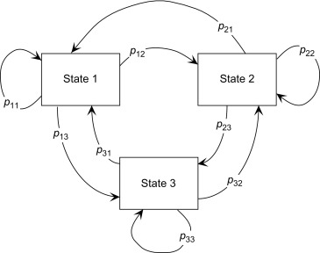
Markov Chains
States: A Markov chain consists of a finite set of states that represent different conditions or scenarios (e.g., weather states: sunny, cloudy, rainy).
Transitions: Movement between states occurs via transitions, each assigned a probability based on the current state. Future states depend only on the current state, adhering to the Markov Property ("memoryless" property).
Transition Matrix: The transitions between states are represented by a transition probability matrix (P), where each element P_{ij} indicates the probability of transitioning from state i to state j.
Initial State: The chain starts in an initial state, typically represented by an initial probability distribution over the states.
Key Assumption: The probability of moving to the next state depends only on the current state, not the sequence of events that preceded it.
States: State1, State2 State3
Transitions: Arrows between states with probabilities

Slide 6
Examples and Use Cases
Input Sequence: "I love to"
Markov Chain Prediction: "I love to eat"
Prediction based on probabilities from training data.
Use Cases:
Simple Chatbot Responses: Generating likely responses based on user input.
Auto-Completion: Predicting and suggesting the next word or phrase as the user types.
Text Generation: Creating text sequences for creative or predictive purposes.

Slide 7
Steps for Text Generation with Markov Chains:
Step 1: Collect and Prepare Text Data:
Preprocess the text by:
Converting text to lowercase
Tokenizing it into words or characters.
Removing punctuations
Step 2: Build the Markov Chain:
Create a data structure to store the Markov Chain, where,
The keys are current words (states)
The values are list of possible next words (transitions)

Slide 8
Steps for Text Generation with Markov Chains:
Example: Given the sentences:
"I love ice cream“
"I love to eat“
"I love coding“
Break these down into unigrams (single words):
"I" -> ["love“,”love”,”love”]
"love" -> ["ice", "to", "coding"]
"ice" -> ["cream"]
"cream" -> [ ]
"to" -> ["eat"]
"eat" -> [ ]
"coding" -> [ ]

Slide 9
Steps for Text Generation with Markov Chains:
Current Word | Possible Next Words
"I" | ["love“,”love”,”love”]
"love" | ["ice", "to", "coding"]
"ice" | ["cream"]
“cream” | []
“to” | [“eat”]
“eat” | []
“coding” | []
Markov Chain Representation:
Step 3: Create the Transition Matrix
Convert the Markov Chain into a transition matrix by calculating the probability of transitioning from one word to the next.
For each word, count how many times each possible next word occurs, and then normalize these counts to probabilities.
Create the transition probability matrix

Slide 10
Steps for Text Generation with Markov Chains:
4. Generate Text
Start with an initial word (seed).
Use the transition matrix to probabilistically choose the next word based on the current word.
Append the chosen word to the generated text.
Repeat the process for a desired number of words or until a termination condition is met.
5. Review and Refine
Review the generated text and assess the coherence.
Adjust the model, input data, or parameters (e.g., seed word, number of generated words) to improve the output.
If needed, consider increasing the Markov Chain order (e.g., bigrams, trigrams) to capture more context.

Slide 11
Summary of Steps – Markov Chain
Text Preparation: Tokenize and clean the input text.
Build the Markov Chain: Create a dictionary linking each word to its possible next words.
Create the Transition Matrix: Calculate the probabilities of transitioning from one word to the next.
Generate Text: Start from a seed word and use the transition matrix to generate a sequence of words.
Review and Refine: Evaluate and refine the generated text for better results.
https://www.youtube.com/watch?v=i3AkTO9HLXo
https://www.youtube.com/watch?v=Uz3JIp6EvIg&t=10s

Slide 12

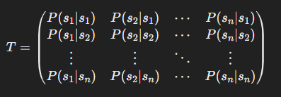
Steps for Text Generation with Markov Chains contd
Transition Probability:
Let S={s1,s2,…,sn} be the set of states (words).
Transition probability from state s_{i} to state s_{j​}
Transition Matrix (First-Order):
A matrix T where each entry T_{ij}​ represents P(s_{j}∣s_{i})
Generate Text:
Start with a seed word or sequence.
Use the transition probability matrix to predict the next word by sampling according to the transition probabilities.
Continue the process to generate a sequence of words until reaching the desired length or end condition.

Slide 13

Text Generation Process
Start with an initial state s₀​.
Select the next state s₁​ based on T_{0j} (probabilities of transitioning from s₀​ to all possible s_{j}
Continue to generate the sequence using the transition matrix until the text is complete.
Simple Example:
Suppose you have a small dataset: "I love ice cream", "I love to eat", "I love coding".
The transition probabilities might be:
Text generation could start with "I" and generate "I love coding" or "I love ice cream" based on the transition probabilities.

Slide 14
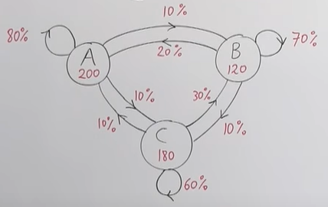
Markov Chains for Predictions

Slide 15
Recurrent Neural Networks (RNNs)
Recurrent Neural Networks (RNNs) are a class of neural networks designed for sequential data.
Unlike traditional neural networks, RNNs have connections that form cycles, allowing them to maintain a 'memory' of previous inputs, which helps in capturing temporal dependencies in sequences.
Architecture:
An RNN processes an input sequence one element at a time, maintaining a hidden state that is updated at each step. The hidden state acts as a memory that captures information about previous inputs in the sequence.
Training:
RNNs are trained using backpropagation through time (BPTT), a variant of backpropagation that considers the temporal nature of the data. The network learns to predict the next word in a sequence by minimizing the prediction error over time.

Slide 16
What is ANN (Artificial Neural Networks)?
Structure: ANNs are the basic form of neural networks, inspired by the way human brains work. They consist of layers of interconnected nodes or "neurons."
Input Layer: Receives the input data.
Hidden Layers: Process the data through weighted connections.
Output Layer: Produces the final output.
Function: Each neuron processes inputs, applies a weighted sum, and passes the result through an activation function to determine the output.
Example:
Use Case: Predicting whether an email is spam or not.
Data Input: Features like the presence of certain words, frequency of words, etc.
Output: A binary value indicating spam or not spam.
Where It's Used:
Simple pattern recognition tasks.
Classification problems like spam detection, image recognition, etc.

Slide 17
What is CNN (Convolutional Neural Networks)?
Structure: CNNs are specialized neural networks designed for processing grid-like data, such as images.
Convolutional Layers: Apply filters (kernels) to the input to detect features like edges, corners, and textures.
Pooling Layers: Reduce the spatial dimensions of the data, keeping the most important features.
Fully Connected Layers: Combine features to make a final prediction.
Function: CNNs are particularly good at detecting spatial hierarchies in data, like detecting small patterns in an image that combine to form a complete object.
Example:
Use Case: Image recognition in a self-driving car.
Data Input: An image of the road.
Output: Identifying objects like cars, pedestrians, traffic signs, etc.
Where It's Used:
Image and video recognition.
Medical image analysis.
Object detection and recognition.

Slide 18
What is RNN (Recurrent Neural Networks)?
Structure: RNNs are designed to handle sequential data. Unlike traditional ANNs, RNNs have connections that form directed cycles, enabling them to maintain a "memory" of previous inputs.
Recurrent Connections: Allow information to persist, making RNNs effective for tasks where the context or order matters.
Function: RNNs process one element of the sequence at a time, passing information from one step of the sequence to the next.
Example:
Use Case: Language translation.
Data Input: A sequence of words in one language.
Output: A sequence of words in another language.
Where It's Used:
Natural Language Processing (NLP).
Time-series prediction (e.g., stock prices).
Speech recognition.

Slide 19
Difference Between ANN, CNN and RNN
Input Type:
ANN: Works with any fixed-size input.
CNN: Best for spatial data like images.
RNN: Designed for sequential data where order matters, like text or time series.
Data Processing:
ANN: Treats all inputs equally, without considering spatial or temporal relationships.
CNN: Focuses on spatial hierarchies, recognizing patterns at different scales.
RNN: Focuses on temporal hierarchies, remembering previous inputs to inform future ones.
Memory:
ANN: No memory; each input is independent.
CNN: No memory; focuses on spatial features.
RNN: Has memory; retains information from previous inputs.

Slide 20
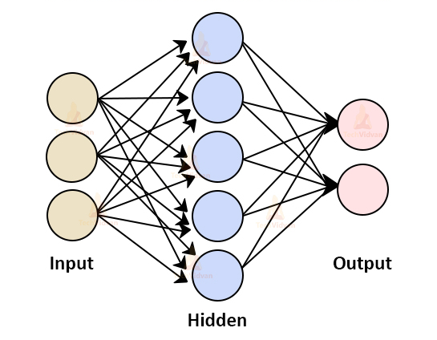
ANN Architecture
Feedforward Neural Networks
This is the simplest type of ANN architecture, where the information flows in one direction from input to output.
The layers are fully connected, meaning each neuron in a layer is connected to all the neurons in the next layer.
Feedforward: Process where input flows through the layers to produce an output.
Backpropagation: Learning mechanism where errors are propagated backward to update weights using gradient descent.

Slide 21
ANN Architecture
Input Layer: Receives input data (e.g., features like pixel values for an image). Each neuron represents a feature, and data is fed forward to the next layer.
Hidden Layer(s): One or more layers where neurons process weighted inputs and apply an activation function (e.g., sigmoid, ReLU) to introduce non-linearity. These layers capture patterns or features from the input data.
Output Layer: Produces the final prediction or output (e.g., classification label, regression value). The number of neurons corresponds to the number of output categories or values.
Weights & Biases: Each connection between neurons has an associated weight (importance of the connection) and bias (threshold for activation).
Activation Functions: Functions (like Sigmoid, ReLU, or Tanh) applied to each neuron’s output to introduce non-linearity, enabling the model to learn complex patterns.

Slide 22
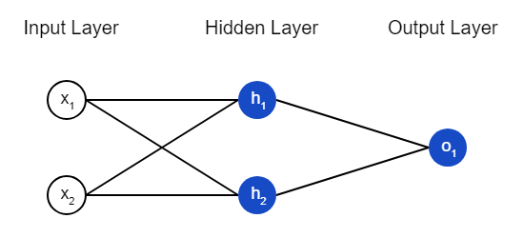
Working of ANN:
Predict whether a student will pass (output = 1) or fail (output = 0) based on two input features:
Hours Studied
Hours Slept
ANN Structure:
Input Layer: 2 neurons (Hours Studied, Hours Slept)
Hidden Layer: 2 neurons
Output Layer: 1 neuron (Pass/Fail)

Slide 23
Step-by-Step Calculation
1. Initialize Weights and Biases
Let's start with some arbitrary weights and biases:
Weights between the input layer and the hidden layer:
w₁₁=0.2, w₁₂=0.4 (for the first hidden neuron)
w₂₁=0.5, w₂₂=0.9 (for the second hidden neuron)
Biases for the hidden layer:
b₁=0.3 (for the first hidden neuron)
b₂=0.7 (for the second hidden neuron)
Weights between the hidden layer and the output layer:
w₁₃=0.8 (for the connection from the first hidden neuron to the output neuron)
w₂₃=1.2 (for the connection from the second hidden neuron to the output neuron)
Bias for the output layer:
b₃=−0.1

Slide 24
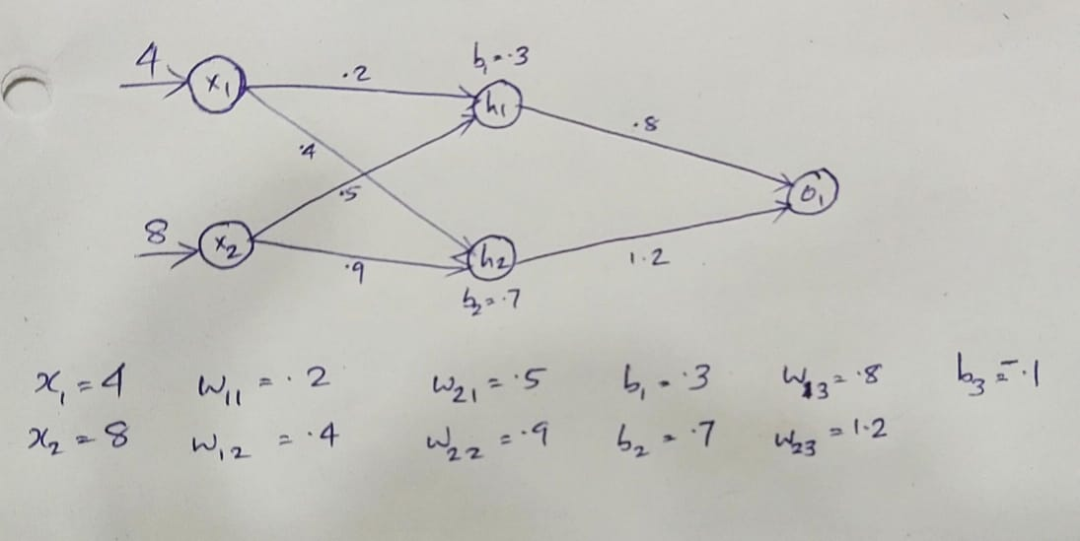
Step-by-Step Calculation
2. Input Values
Let’s consider an example where a student studied for 4 hours and slept for 8 hours:
x₁=4 (Hours Studied)
x₂=8 (Hours Slept)
3. Calculate the Output of the Hidden Layer Neurons
Hidden Layer Calculations
Each input is multiplied by a weight:
x₁→x₁∗ w₁₁
​x₂→x₂∗ w₁₂ ​
Next, all the weighted inputs are added together with a bias b:
(x₁∗w₁₁)+(x₂∗w₁₂)+b
Finally, the sum is passed through an activation function:
y=f(x₁∗w₁₁)+(x₂∗w₁₂)+b)
where:
x₁​ and x₂​ are the input values (Hours Studied and Hours Slept).
w_{1j} and w_{2j} are the weights connecting the inputs to the hidden neuron j.
b_{j} is the bias for the hidden neuron j
z_{j​} is the weighted sum before applying the activation function.

Slide 25

Step-by-Step Calculation
Hidden Layer Calculations continued…
Activation Function (using Sigmoid in this case):
For each neuron in the hidden layer, calculate the weighted sum of inputs, add the bias, and apply an activation function. We'll use the sigmoid activation function:
$a_{j}=Sigmoid\left(z\right)= \frac{1}{1+e^{−z}}$
where, a_{j}​ is the output of the hidden neuron j after applying the activation function.

Slide 26
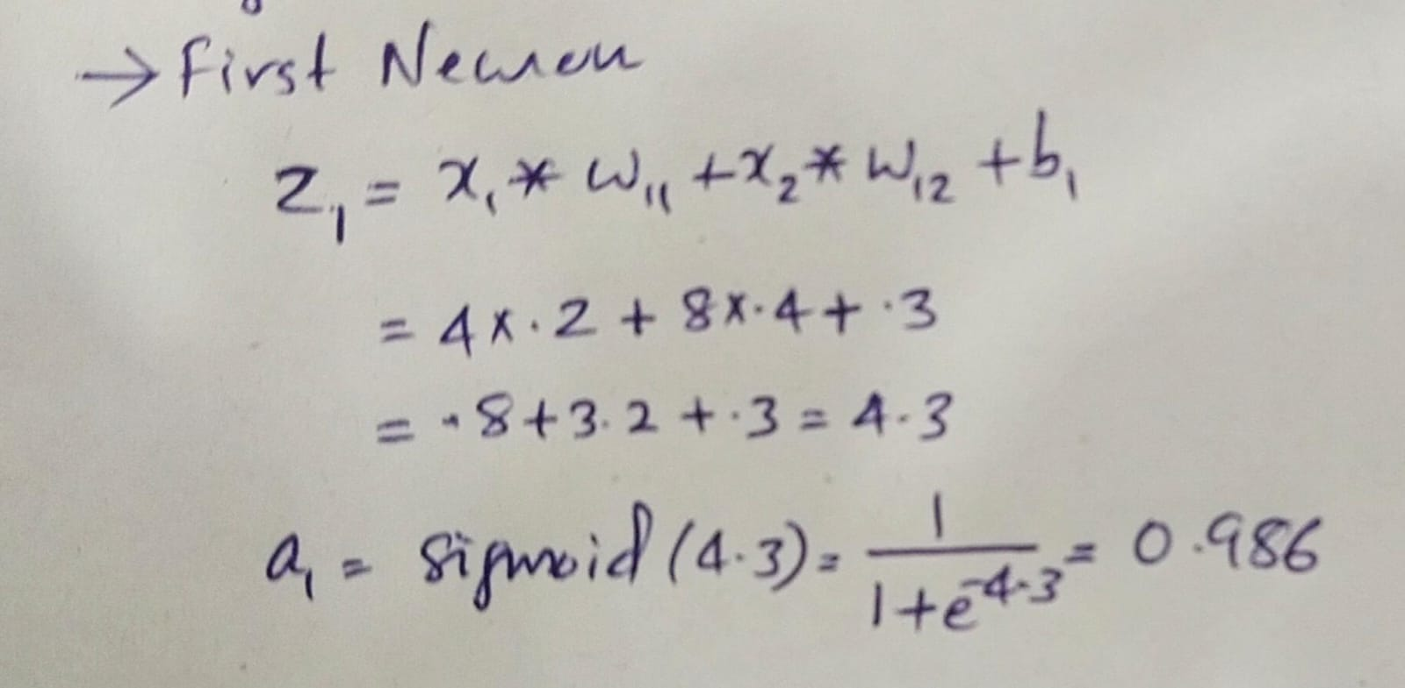
Step-by-Step Calculation

Slide 27
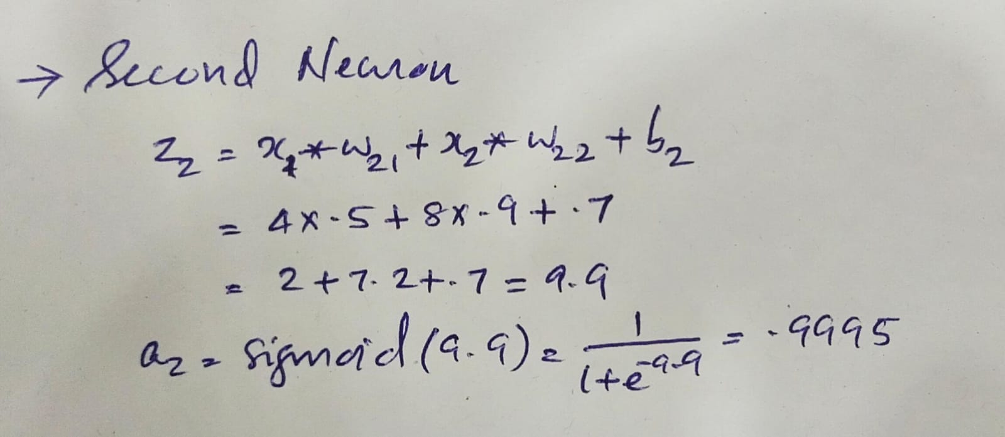
Step-by-Step Calculation

Slide 28
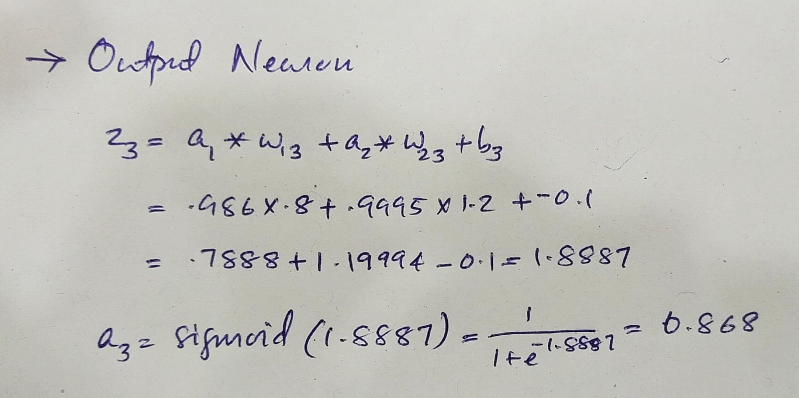
Step-by-Step Calculation

Slide 29
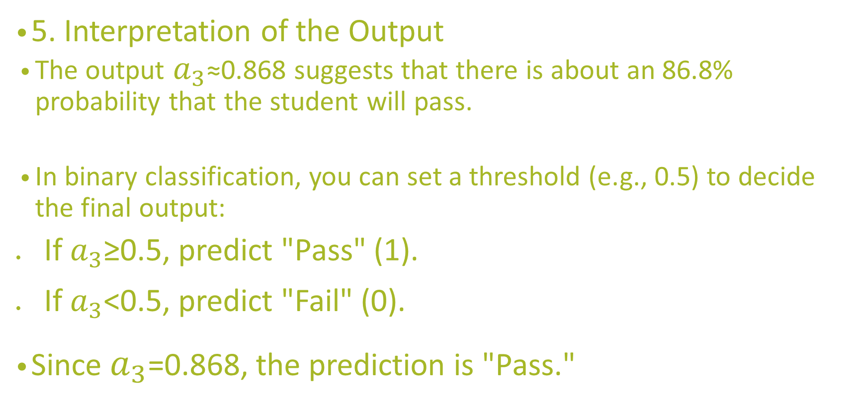
Step-by-Step Calculation
5. Interpretation of the Output
The output $a_{3}$≈0.868 suggests that there is about an 86.8% probability that the student will pass.
In binary classification, you can set a threshold (e.g., 0.5) to decide the final output:
If $a_{3}$≥0.5, predict "Pass" (1).
If $a_{3}$<0.5, predict "Fail" (0).
Since $a_{3}$=0.868, the prediction is "Pass."

Slide 30
Resources for ANN
https://www.youtube.com/watch?v=quCEmM2JBbk
https://www.youtube.com/watch?v=npeMAZWvjbU
https://www.youtube.com/watch?v=aircAruvnKk

Slide 31
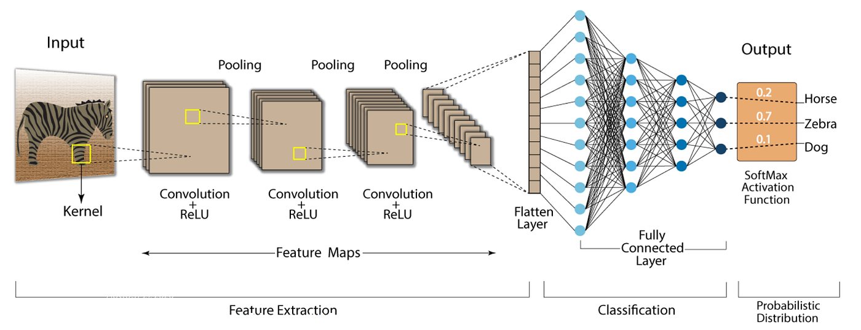
CNN Architecture
These networks are designed to process data with a grid-like topology, such as images.
The layers consist of convolutional layers, which learn to detect specific features in the data, and pooling layers, which reduce the spatial dimensions of the data.

Slide 32
CNN Architecture
Input Layer:
Receives input data, typically image pixels (e.g., a 2D matrix of pixel values for an image).
Convolutional Layer:
Applies filters (kernels) that slide over the input data to extract local features (edges, textures, etc.).
Generates a feature map by performing convolution operations.
Key parameters: filter size, stride, padding.
Activation Function:
Introduces non-linearity (e.g., ReLU) to the feature map, allowing the network to capture complex patterns.
Pooling Layer:
Performs down-sampling (e.g., max pooling) to reduce the spatial dimensions of the feature maps while retaining important features.
Fully Connected Layer:
Flattens the feature maps into a vector and passes it through one or more fully connected layers for classification or regression tasks.
Output Layer:
Provides the final output, such as class probabilities, through a softmax or similar function.

Slide 33
Working of CNN
Task: Classification of a small image.
Let’s say we have a grayscale image (1 channel) of size 4x4 pixels, and the task is to classify it into one of two classes (e.g., Class A or Class B).
CNN Structure:
Input Layer: 4x4 grayscale image (1 channel)
Convolutional Layer: 1 filter (3x3), stride 1, no padding
ReLU Activation Function
Pooling Layer: 2x2 max pooling, stride 2
Fully Connected Layer: 2 neurons (one for each class)

Slide 34
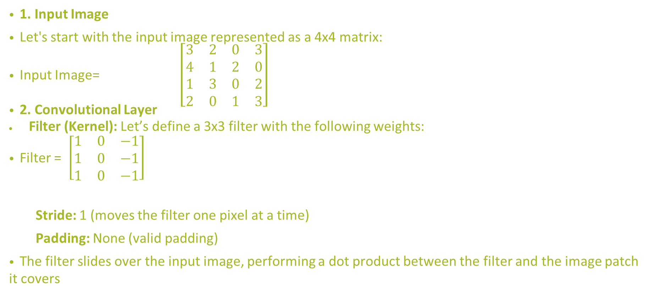
Step-by-Step Calculation
1. Input Image
Let's start with the input image represented as a 4x4 matrix:
Input Image= $\left[\begin{matrix}3 & 2 & 0 & 3 \\ 4 & 1 & 2 & 0 \\ 1 & 3 & 0 & 2 \\ 2 & 0 & 1 & 3\end{matrix}\right]$
2. Convolutional Layer
Filter (Kernel): Let’s define a 3x3 filter with the following weights:
Filter = $\left[\begin{matrix}1 & 0 & −1 \\ 1 & 0 & −1 \\ 1 & 0 & −1\end{matrix}\right]$
​​
Stride: 1 (moves the filter one pixel at a time)
Padding: None (valid padding)
The filter slides over the input image, performing a dot product between the filter and the image patch it covers

Slide 35
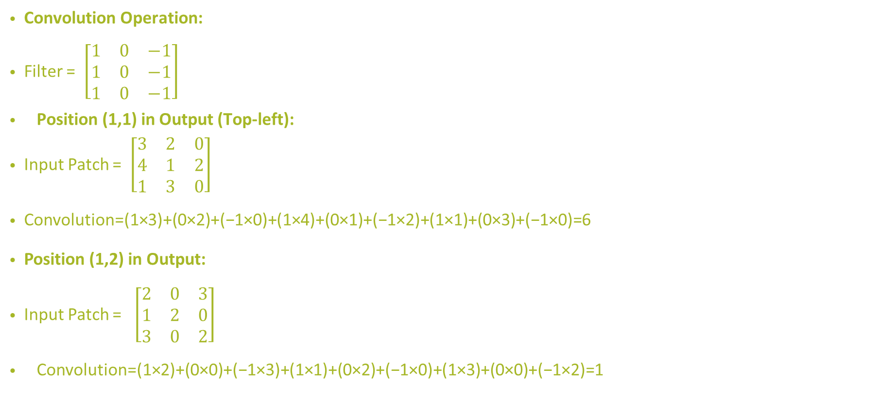
Step-by-Step Calculation
Convolution Operation:
Filter = $\left[\begin{matrix}1 & 0 & −1 \\ 1 & 0 & −1 \\ 1 & 0 & −1\end{matrix}\right]$
Position (1,1) in Output (Top-left):
Input Patch = $\left[\begin{matrix}3 & 2 & 0 \\ 4 & 1 & 2 \\ 1 & 3 & 0\end{matrix}\right]$
Convolution=(1×3)+(0×2)+(−1×0)+(1×4)+(0×1)+(−1×2)+(1×1)+(0×3)+(−1×0)=6
Position (1,2) in Output:
Input Patch = $\left[\begin{matrix}2 & 0 & 3 \\ 1 & 2 & 0 \\ 3 & 0 & 2\end{matrix}\right]$
Convolution=(1×2)+(0×0)+(−1×3)+(1×1)+(0×2)+(−1×0)+(1×3)+(0×0)+(−1×2)=1

Slide 36
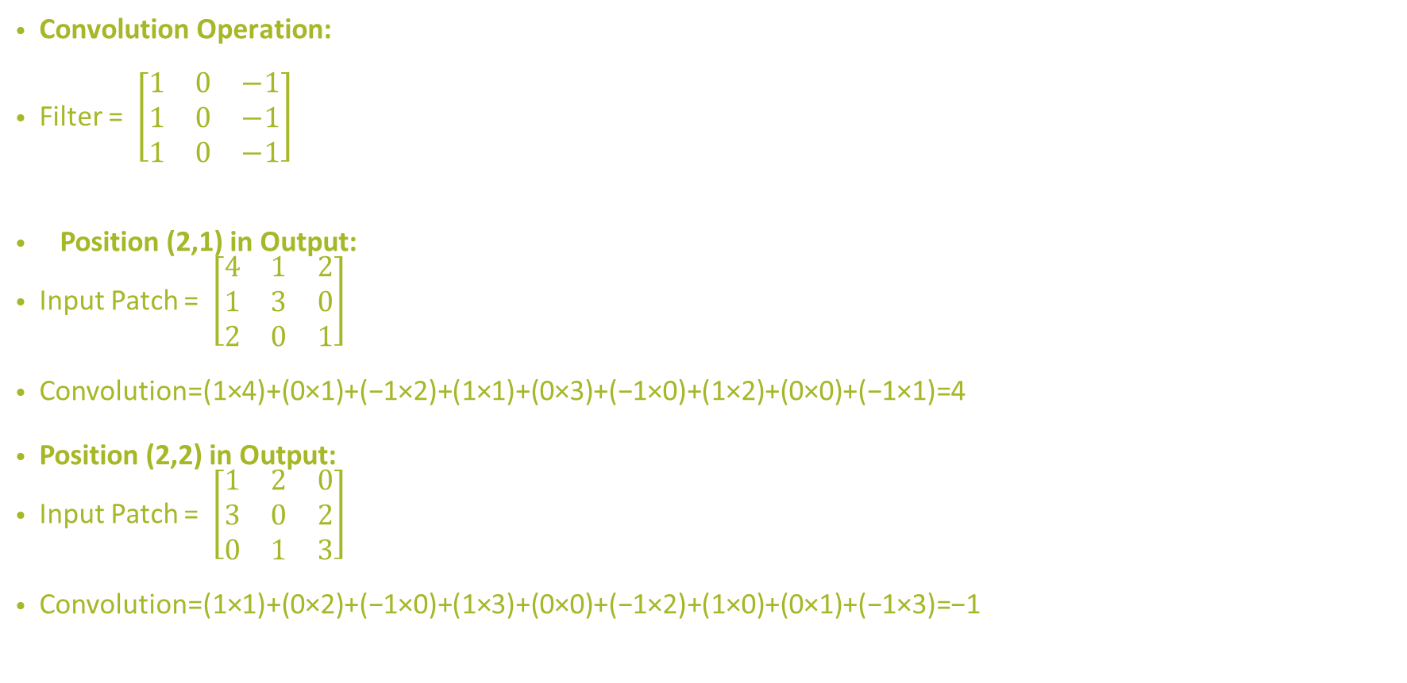
Step-by-Step Calculation
Convolution Operation:
Filter = $\left[\begin{matrix}1 & 0 & −1 \\ 1 & 0 & −1 \\ 1 & 0 & −1\end{matrix}\right]$
Position (2,1) in Output:
Input Patch = $\left[\begin{matrix}4 & 1 & 2 \\ 1 & 3 & 0 \\ 2 & 0 & 1\end{matrix}\right]$
Convolution=(1×4)+(0×1)+(−1×2)+(1×1)+(0×3)+(−1×0)+(1×2)+(0×0)+(−1×1)=4
Position (2,2) in Output:
Input Patch = $\left[\begin{matrix}1 & 2 & 0 \\ 3 & 0 & 2 \\ 0 & 1 & 3\end{matrix}\right]$
Convolution=(1×1)+(0×2)+(−1×0)+(1×3)+(0×0)+(−1×2)+(1×0)+(0×1)+(−1×3)=−1

Slide 37
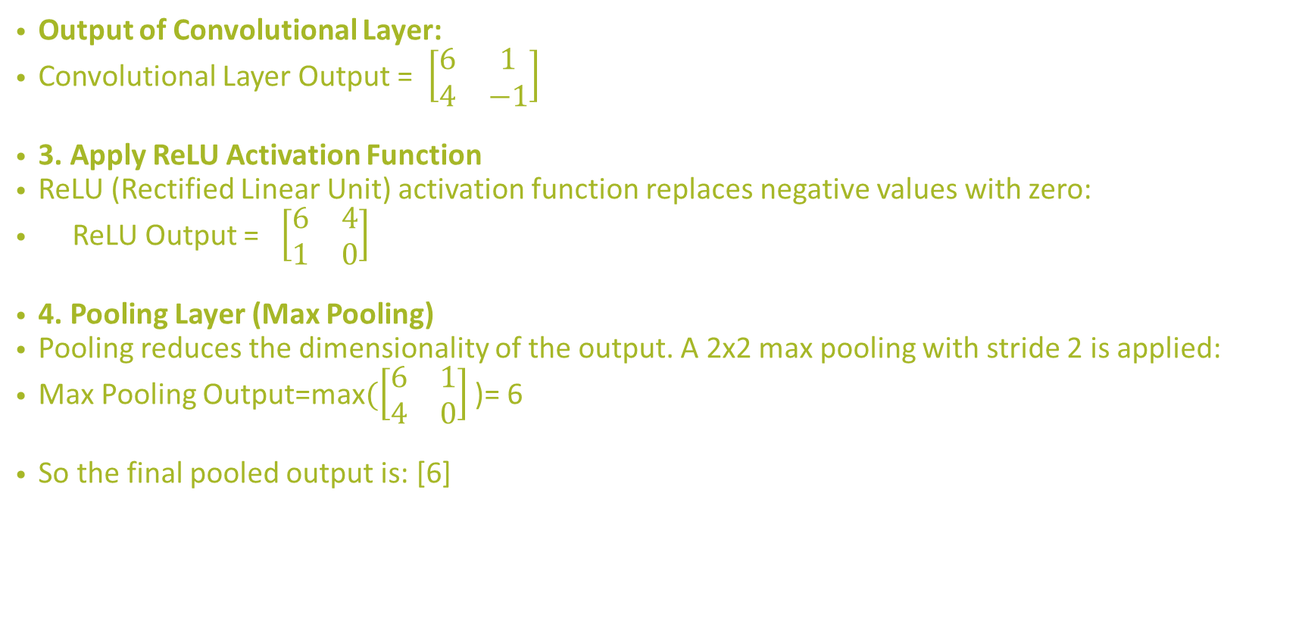
Step-by-Step Calculation
Output of Convolutional Layer:
Convolutional Layer Output = $\left[\begin{matrix}6 & 1 \\ 4 & −1\end{matrix}\right]$
3. Apply ReLU Activation Function
ReLU (Rectified Linear Unit) activation function replaces negative values with zero:
ReLU Output = $\left[\begin{matrix}6 & 4 \\ 1 & 0\end{matrix}\right]$
4. Pooling Layer (Max Pooling)
Pooling reduces the dimensionality of the output. A 2x2 max pooling with stride 2 is applied:
Max Pooling Output=max$(\left[\begin{matrix}6 & 1 \\ 4 & 0\end{matrix}\right]$ )= 6
So the final pooled output is: [6]

Slide 38
Step-by-Step Calculation
5. Fully Connected Layer
In the fully connected layer, the output from the pooling layer is flattened into a single vector and passed through the network.
Assume the fully connected layer has weights w₁=0.5 and w₂=−0.5 for two classes, and the input from pooling is directly connected:
Input to Fully Connected Layer:
Input=[6]
Weights: Let’s assume a bias of 1 for simplicity.
Class A Calculation:
z_{A}=6×0.5+1=3+1=4
Class B Calculation:
z_{B}=6×−0.5+1=−3+1=−2
6. Output Layer and Prediction
Finally, the network's output is fed through a softmax function to convert the logits into probabilities. However, since Class A has a higher score, the network would classify the image into Class A.

Slide 39

Summary of Equations:
Convolution Operation:
$z=\sum_{i=1}^{n}{\sum_{j=1}^{m}{\left({input}_{ij}∗{filter}_{ij}+bias\right)}}$
where n and m are the dimensions of the filter.
ReLU Activation Function:
ReLU(z)=max(0,z)
Max Pooling:
Pooled Output=max(ReLU Patch)
Fuly Connected Layer:
z=∑​(Pooled Output_{i}​×w_{i​})+Bias
Each input is multiplied by a weight:
x₁→x₁∗w₁₁
​x₂→x₂∗w₁₂ ​
Next, all the weighted inputs are added together with a bias b:
(x₁∗w₁₁)+(x₂∗w₁₂)+b
Finally, the sum is passed through an activation function:
y=f(x₁∗w₁+x₂∗w₂+b)

Slide 40
Resources for CNN
Convolution - https://www.youtube.com/watch?v=gLwX3zHkims&list=PLuhqtP7jdD8CD6rOWy20INGM44kULvrHu&index=2
Padding - https://www.youtube.com/watch?v=-1xVmU8Z6Bs&list=PLuhqtP7jdD8CD6rOWy20INGM44kULvrHu&index=3
Stride in CNN - https://www.youtube.com/watch?v=lxk_nmpqI5M&list=PLuhqtP7jdD8CD6rOWy20INGM44kULvrHu&index=4
Max Pooling - https://www.youtube.com/watch?v=zg_AA3fZpE0&list=PLuhqtP7jdD8CD6rOWy20INGM44kULvrHu&index=5
Fully Connected Layer - https://www.youtube.com/watch?v=rxSmwM7z0_4&list=PLuhqtP7jdD8CD6rOWy20INGM44kULvrHu&index=6
CNN Architecture - https://www.youtube.com/watch?v=VF4BDE7uqY0&list=PLuhqtP7jdD8CD6rOWy20INGM44kULvrHu&index=7

Slide 41
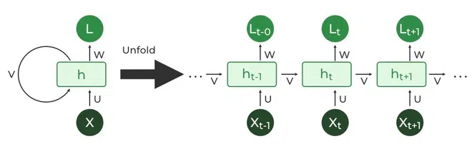
RNN Architecture
These networks have a “memory” component, where information can flow in cycles through the network.
This allows the network to process sequences of data, such as time series or speech.

Slide 42
RNN Architecture
Input Layer:
Processes sequential data (e.g., text, time series). Each input is fed one step at a time (e.g., words in a sentence, one after the other).
Hidden Layer(s):
Each hidden layer has recurrent connections that allow information to pass from one step to the next.
At each time step, the hidden state is updated based on the current input and the previous hidden state.
Shared weights across time steps enable learning from sequential dependencies.
Recurrent Connections:
The key feature of RNNs: loops that allow information to persist and handle sequence data.
The hidden state from the previous step is fed back into the network for the next step.
Activation Function:
Typically uses tanh or ReLU to introduce non-linearity in the hidden layers.
Output Layer:
Produces the output at each time step (e.g., next word in a sequence) or a final output after processing the entire sequence (e.g., sentiment classification).

Slide 43
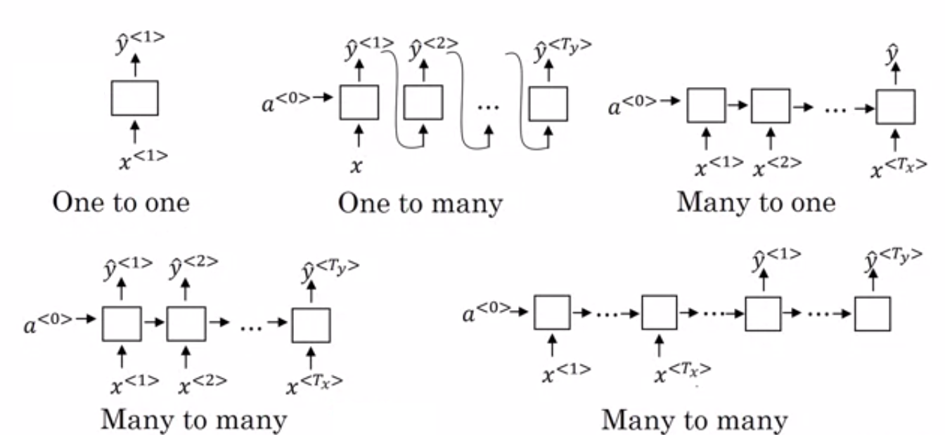
Types of RNN Architectures

Slide 44
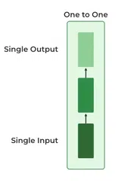
Different RNN Architectures One-to-One RNN
Use Cases:
Image Captioning: One image is the input, and the output is a sequence of words (a caption) describing the image.
Music Generation: Given a musical note (or chord), the model generates a sequence of notes as output.
Architecture: RNN processes a single input and produces a single output.
Explanation: Not commonly used in RNNs since RNNs are designed for sequences, but a one-to-one RNN would be analogous to a simple neural network where the input and output are not sequences.

Slide 45
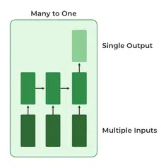
Different RNN Architectures Many-to-One RNN
Use Cases:
Sentiment Analysis: A sequence of words (from a review or tweet) is processed, and the output is a sentiment label (positive, negative, neutral).
Spam Detection: An email (word sequence) is processed to output whether it’s spam or not.
Sequence Classification: Text classification, like assigning a category to a news article based on its content.
Architecture: The RNN processes a sequence of inputs and produces a single output.
Explanation: The entire input sequence (e.g., a sentence or time series) is processed, and the final hidden state is used to produce the output (e.g., sentiment score, category label).

Slide 46
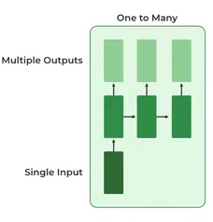
Different RNN Architectures One-to-Many RNN
Use Cases:
Image Captioning: The RNN generates a sequence of words (a caption) based on the features extracted from an input image.
Music Generation: The RNN produces a sequence of notes or musical elements starting from an initial input note or theme.
Architecture: The RNN takes a single input and produces a sequence of outputs.
Explanation: A single input (e.g., an image) is processed to generate a sequence of outputs (e.g., words forming a caption).

Slide 47
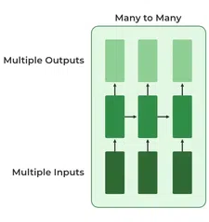
Different RNN Architectures Many-to-Many RNN
Use Cases:
Named Entity Recognition (NER): Each word in a sentence is labeled with a category (e.g., "person," "location").
Video Frame Classification: Classifying each frame of a video as "action”, "non-action," etc.
Language Translation: Translating a sentence from one language to another (e.g., from English to French). Input and output sentence lengths differ.
Speech-to-Text: Processing an audio signal (of varying length) and
producing the corresponding text output. (Unequal length)
Architecture: The RNN processes a sequence of inputs and produces a sequence of outputs.
Explanation: The input sequence (e.g., an English sentence) is processed, and a corresponding output sequence (e.g., a French sentence) is generated.
Many-to-Many Variants:
Equal Length: Used in cases like video frame labeling, where each frame corresponds to a label.
Unequal Length: Used in tasks like translation, where the input and output sequences may have different lengths.

Slide 48
Working of RNN
Task: Predicting the next character in a sequence of letters.
Let’s say our input sequence is “CAR" and we want to predict the next letter, which is “D".
RNN Structure:
Input Sequence: “C”, “A”, “R"
Input Representation: Each letter is represented as a one-hot vector.
Hidden Layer: 2 units (to keep calculations simple)
Output Layer: 1 unit (since we have to predict the character, “D")

Slide 49
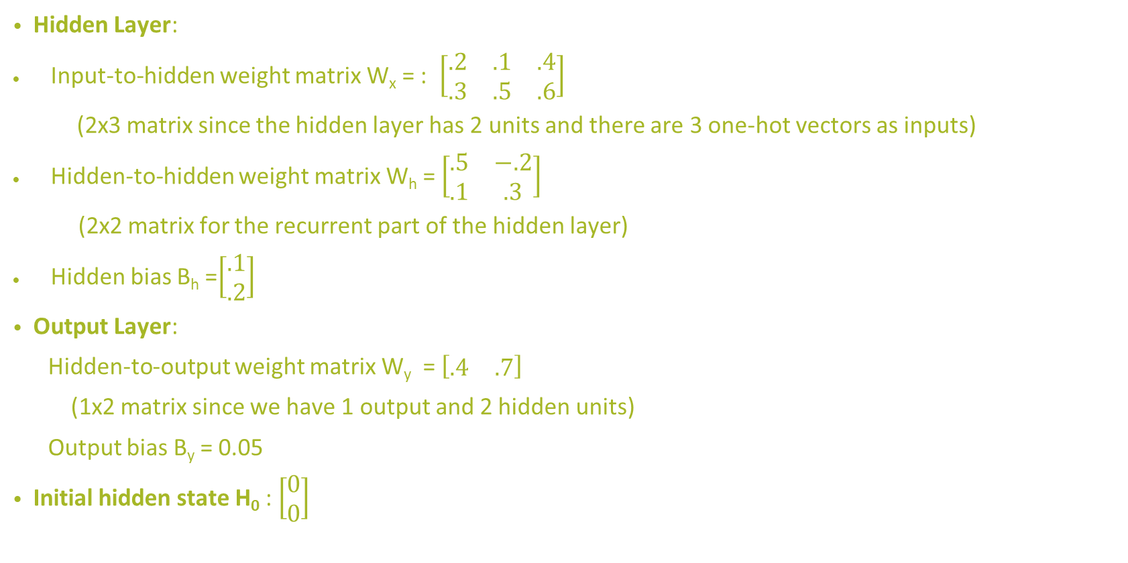
Initial Parameters
Hidden Layer:
Input-to-hidden weight matrix W_{x} = : $\left[\begin{matrix}.2 & .1 & .4 \\ .3 & .5 & .6\end{matrix}\right]$
(2x3 matrix since the hidden layer has 2 units and there are 3 one-hot vectors as inputs)
Hidden-to-hidden weight matrix W_{h} = $\left[\begin{matrix}.5 & −.2 \\ .1 & .3\end{matrix}\right]$
(2x2 matrix for the recurrent part of the hidden layer)
Hidden bias B_{h} =$\left[\begin{matrix}.1 \\ .2\end{matrix}\right]$
Output Layer:
Hidden-to-output weight matrix W_{y} = $\left[\begin{matrix}.4 & .7\end{matrix}\right]$
(1x2 matrix since we have 1 output and 2 hidden units)
Output bias B_{y} = 0.05
Initial hidden state H₀ : $\left[\begin{matrix}0 \\ 0\end{matrix}\right]$

Slide 50

Step-by-Step Calculation
1. Input "C"
One-Hot encoded Representation for “C” = $\left[\begin{matrix}1 \\ 0 \\ 0\end{matrix}\right]$
Hidden State Calculation:
$Z_{H}^{<t−1>}$= W_{x}⋅X_{C}+W_{h}⋅H₀+B_{h})
= $\left[\begin{matrix}.2 & .1 & .4 \\ .3 & .5 & .6\end{matrix}\right]∗ \left[\begin{matrix}1 \\ 0 \\ 0\end{matrix}\right]+ \left[\begin{matrix}.5 & −.2 \\ .1 & .3\end{matrix}\right]∗ \left[\begin{matrix}0 \\ 0\end{matrix}\right]+ \left[\begin{matrix}.1 \\ .2\end{matrix}\right]$
= $\left[\begin{matrix}.2 \\ .3\end{matrix}\right]+ \left[\begin{matrix}0 \\ 0\end{matrix}\right]+ \left[\begin{matrix}.1 \\ .2\end{matrix}\right]$)
= $\left[\begin{matrix}.3 \\ .5\end{matrix}\right]$
Now, H_{t-1} = A( $Z_{H}^{<t−1>}$)
ie, H_{t-1} = tanh($\left[\begin{matrix}.3 \\ .5\end{matrix}\right]$ ) = $\left[\begin{matrix}.2913 \\ .4621\end{matrix}\right]$

Slide 51

Step-by-Step Calculation
2. Input "A“
One-Hot encoded Representation for “A” = $\left[\begin{matrix}0 \\ 1 \\ 0\end{matrix}\right]$
Hidden State Calculation:
$Z_{H}^{<t>}$= W_{x}⋅X_{A}+W_{h}⋅H_{t-1}+B_{h})
= $\left[\begin{matrix}.2 & .1 & .4 \\ .3 & .5 & .6\end{matrix}\right]∗ \left[\begin{matrix}0 \\ 1 \\ 0\end{matrix}\right]+ \left[\begin{matrix}.5 & −.2 \\ .1 & .3\end{matrix}\right]∗ \left[\begin{matrix}0.2913 \\ 0.4621\end{matrix}\right]+ \left[\begin{matrix}.1 \\ .2\end{matrix}\right]$
= $\left[\begin{matrix}.1 \\ .5\end{matrix}\right]+ \left[\begin{matrix}.5323 \\ .1667\end{matrix}\right]+ \left[\begin{matrix}.1 \\ .2\end{matrix}\right]$)
= $\left[\begin{matrix}.7323 \\ .8667\end{matrix}\right]$
Now, H_{t} = A( $Z_{H}^{<t>}$)
ie, H_{t} = tanh($\left[\begin{matrix}.7323 \\ .8667\end{matrix}\right]$ ) = $\left[\begin{matrix}.6245 \\ .6997\end{matrix}\right]$

Slide 52

Step-by-Step Calculation
3. Input "R"
One-Hot encoded Representation for “C” = $\left[\begin{matrix}0 \\ 0 \\ 1\end{matrix}\right]$
Hidden State Calculation:
$Z_{H}^{<t+1>}$= W_{x}⋅X_{R}+W_{h}⋅H_{t+1}+B_{h})
= $\left[\begin{matrix}.2 & .1 & .4 \\ .3 & .5 & .6\end{matrix}\right]∗ \left[\begin{matrix}0 \\ 0 \\ 1\end{matrix}\right]+ \left[\begin{matrix}.5 & −.2 \\ .1 & .3\end{matrix}\right]∗ \left[\begin{matrix}.6245 \\ .6997\end{matrix}\right]+ \left[\begin{matrix}.1 \\ .2\end{matrix}\right]$
= $\left[\begin{matrix}.4 \\ .6\end{matrix}\right]+ \left[\begin{matrix}.1724 \\ .8344\end{matrix}\right]+ \left[\begin{matrix}.1 \\ .2\end{matrix}\right]$)
= $\left[\begin{matrix}.6724 \\ 1.6344\end{matrix}\right]$
Now, H_{t+1} = A( $Z_{H}^{<t+1>}$)
ie, H_{t+1} = tanh($\left[\begin{matrix}.6724 \\ 1.6344\end{matrix}\right]$ ) = $\left[\begin{matrix}.5866 \\ .9267\end{matrix}\right]$

Slide 53

Step-by-Step Calculation
Final Output State Calculation
Compute the final output Y:
Y = W_{y}⋅H_{t+1}+B_{y}
= $\left[\begin{matrix}.4 & .7\end{matrix}\right]$ * $\left[\begin{matrix}.5866 \\ .9267\end{matrix}\right]$ + 0.05
= .8833 * 0.05 = .9333

Slide 54
Step-by-Step Calculation
In a regression context, the output y ​ should ideally approximate the next number in the sequence. Here, y≈0.9333, which is not close to 8 but demonstrates how the RNN processes inputs.
This suggests that the network is not well-trained or that its parameters need adjustment to accurately predict the next number in the sequence.
With proper training (e.g., adjusting weights and biases through backpropagation and gradient descent), the RNN would learn to output a value closer to the actual output for this sequence (“D”).

Slide 55
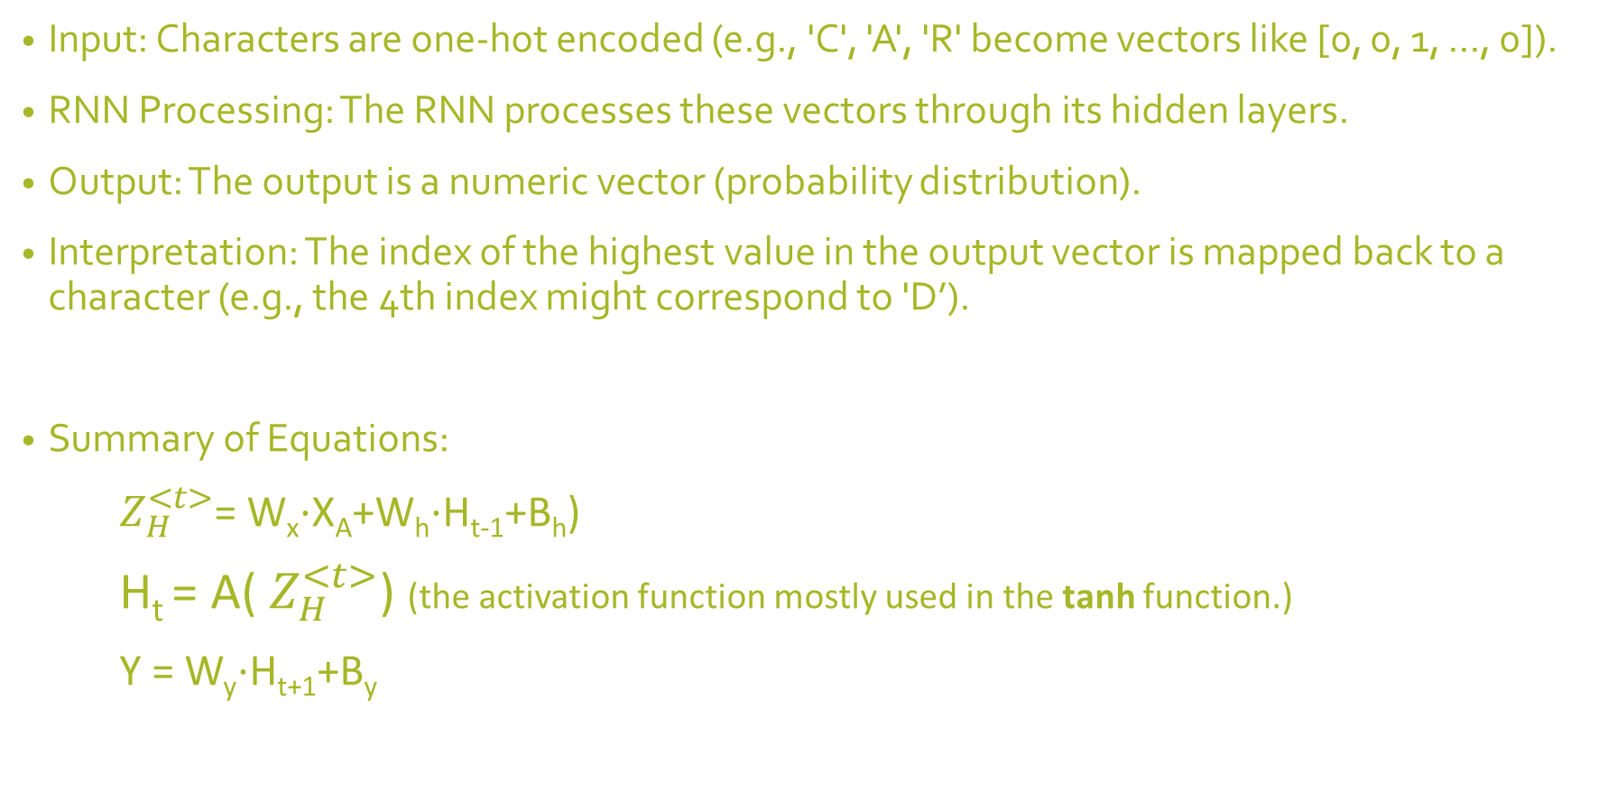
Summary of the Process
Input: Characters are one-hot encoded (e.g., 'C', 'A', 'R' become vectors like [0, 0, 1, ..., 0]).
RNN Processing: The RNN processes these vectors through its hidden layers.
Output: The output is a numeric vector (probability distribution).
Interpretation: The index of the highest value in the output vector is mapped back to a character (e.g., the 4th index might correspond to 'D’).
Summary of Equations:
$Z_{H}^{<t>}$= W_{x}⋅X_{A}+W_{h}⋅H_{t-1}+B_{h})
H_{t} = A( $Z_{H}^{<t>}$) (the activation function mostly used in the tanh function.)
Y = W_{y}⋅H_{t+1}+B_{y}

Slide 56
Text Generation with RNNs:
Seed Sequence: Start with a seed sequence (a few words).
Predict and Append: Use the RNN to predict the next word, append it to the sequence, and use the updated sequence as the input for the next prediction.
Repeat: Continue the process until the desired length of text is generated.
Challenges:
Vanishing/Exploding Gradients: RNNs can suffer from vanishing or exploding gradients during training, making it difficult to learn long-term dependencies.
Limited Memory: Standard RNNs have limited capacity to remember long `sequences, leading to challenges in generating coherent long texts.
https://www.youtube.com/watch?v=epUXJE65jh8

Slide 57
Resources for RNN
What is RNN in Deep Learning - https://www.youtube.com/watch?v=lWPkNkShNbo&list=PLuhqtP7jdD8ARBnzj8SZwNFhwWT89fAFr
Types of RNNs - https://www.youtube.com/watch?v=R2ZhLI2-vHI&list=PLuhqtP7jdD8ARBnzj8SZwNFhwWT89fAFr&index=2
RNN Model Architecture - https://www.youtube.com/watch?v=7ZQgK_MV_t0&list=PLuhqtP7jdD8ARBnzj8SZwNFhwWT89fAFr&index=3
RNNs: https://www.youtube.com/watch?v=y9PLF2GsD-c
https://www.youtube.com/watch?v=LHXXI4-IEns
Simple Explanation: https://www.youtube.com/watch?v=KBftoy0DPxI&t=354s

Slide 58
Advanced RNN Variants:
Long Short-Term Memory (LSTM): LSTM networks include mechanisms like forget gates, input gates, and output gates to better manage long-term dependencies and mitigate the vanishing gradient problem.
Gated Recurrent Unit (GRU): GRUs are a simpler variant of LSTMs with similar capabilities but fewer parameters.

Slide 59
Long Short-Term Memory (LSTM)
A type of RNN designed to capture long-term dependencies in sequences with mechanisms like gates that control the flow of information.
Addresses the vanishing gradient problem that standard RNNs face during backpropagation through time.
Capable of remembering information for long periods of time and forgetting irrelevant information.
Strengths of LSTMs:
Handles long sequences better than RNNs.
Flexible memory: Can selectively "remember" and "forget" data over time.
Effective in sequence prediction and tasks requiring memory of distant information.

Slide 60
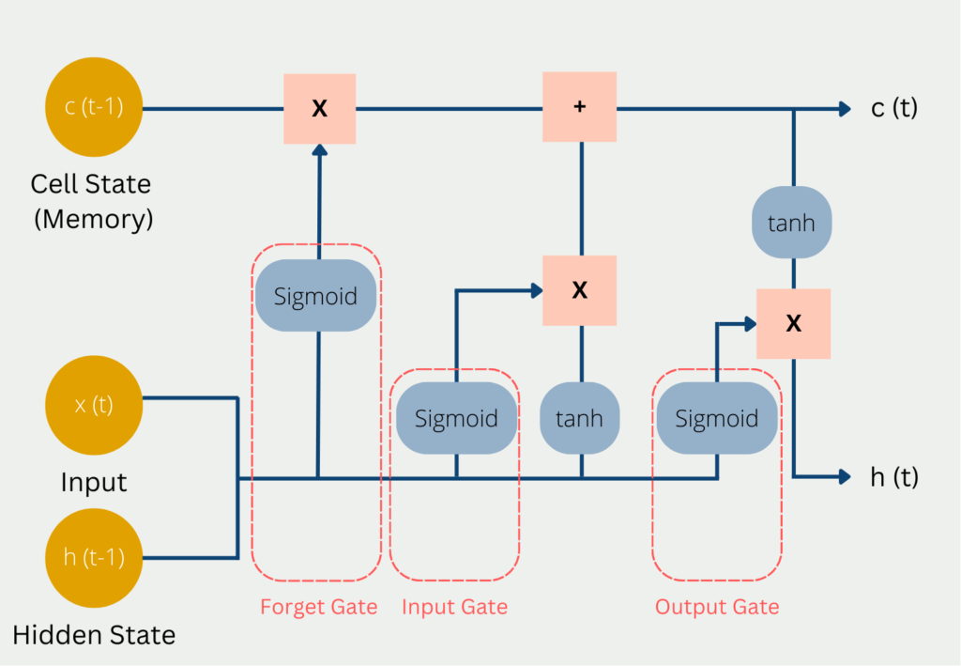
LSTM Architecture
A type of RNN designed to capture long-term dependencies with mechanisms like gates that control the flow of information.
Key Components:
Forget Gate: Controls which parts of the cell state are discarded.
Input Gate: Adds new information into the cell state.
Cell State: The memory unit of LSTM that flows through the network, updated at each step.
Output Gate: Determines the final output at each time step based on the cell state and hidden state.

Slide 61
Flow of Data in LSTM
Input gate selects important information to add to the cell.
Forget gate removes unnecessary information from the cell.
Cell state is updated with new and retained information.
Output gate generates the required output.

Slide 62
Flow of Data in LSTM
Forget Gate:
Decides what portion of the previous cell state should be forgotten.
Takes the hidden state (h{t-1}) and the current input (x_t), processes them with a sigmoid activation function, and outputs a value between 0 and 1 for each number in the cell state.
0 means “completely forget” and 1 means “completely retain”.
Input Gate:
Determines which parts of the new information (from the current input) should be added to the cell state.
First, a sigmoid function decides which values to update (acts as a filter).
Then, a tanh layer creates a vector of candidate values, which are scaled and added to the cell state.
Update Cell State:
The cell state is updated by combining the effect of the forget gate and the input gate.
This allows LSTM to retain important long-term information (using the forget gate) and add useful short-term data (through the input gate) to the cell state.
Output Gate:
Produces the output for the current time step, which is also the new hidden state (h_t) passed to the next LSTM unit.
The output gate looks at the updated cell state and decides what part of it to output based on the sigmoid function and tanh applied to the cell state.

Slide 63
LSTM - Use Cases
Speech Recognition: Converting spoken words into text by remembering long-term dependencies in speech patterns.
Language Translation: Translating sentences from one language to another while maintaining context across entire sentences.
Music Composition: Composing music by learning patterns and structures in sequences of notes over time.
Sentiment Analysis: LSTMs are used in many-to-one RNNs to analyze the sentiment of a sentence or document based on its entire content.
Speech Recognition: LSTMs can model sequences of acoustic signals to transcribe speech into text.
Time Series Forecasting: LSTMs can predict future values in a time series by learning patterns and dependencies from historical data, such as stock prices or weather data.
Handwriting Recognition: LSTMs can recognize handwritten text by processing sequences of strokes or pen movements.

Slide 64
Gated Recurrent Unit (GRU)
A simpler variant of LSTMs with similar capabilities but fewer parameters.
Developed to address the vanishing gradient problem in standard RNNs while being computationally efficient.
Like LSTMs, GRUs manage long-term dependencies without using separate memory cells.
Key differences from LSTMs:
Fewer gates: GRUs combine the forget and input gates into a single gate.
No separate cell state: GRUs directly expose the hidden state.
GRUs are simpler, faster, and often perform comparably to LSTMs on tasks like language modeling, machine translation, and speech recognition.

Slide 65
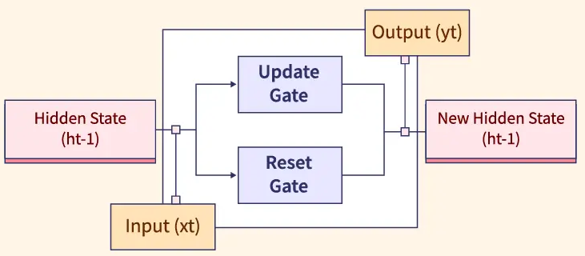
GRU Architecture
Update Gate:
Determines how much of the previous hidden state (h{t-1}) should be carried forward to the current time step.
A sigmoid function processes the hidden state (h{t-1}) and the current input (x_t) to output a value between 0 and 1.
0 means no update (forget entirely) and 1 means full retention (carry forward everything).
Reset Gate:
Decides how much of the previous hidden state to forget before combining it with the current input.
Uses a sigmoid function similar to the update gate.
Controls the extent to which past information influences the current computation.

Slide 66
Flow of Data in GRUs
Reset Gate Operation:
The reset gate decides how much of the hidden state (h_{t-1}) should be mixed with the current input (x_t).
If reset gate is close to 0, the past information is largely ignored, making the model behave as if it’s processing the input independently.
Current Memory Content:
Once the reset gate has determined how much past information is relevant, a tanh activation generates candidate memory content that will form part of the new hidden state.
Update Gate Operation:
The update gate computes the extent to which the hidden state (h_t) will be updated with the new candidate content.
A combination of past hidden state and the new memory content (via the update gate) produces the final hidden state.
Final Hidden State (h_t):
Combines old information (carried through by the update gate) and the newly computed memory content.
Unlike LSTMs, GRUs skip the output gate and directly produce the updated hidden state.

Slide 67
GRU – Use Cases
Chatbots: Managing conversations by maintaining context over multiple turns in a dialogue (e.g., personal assistants like Siri, Alexa).
Video Processing: Understanding sequences of video frames for tasks like action recognition and video captioning.
Anomaly Detection: Detecting unusual patterns in time-series data, such as fraud detection in banking transactions or server monitoring.

Slide 68
Neural Machine Translation (NMT)
Neural Machine Translation (NMT) is a deep learning approach to translating text from one language to another.
Architecture: Typically built using an encoder-decoder model (often with RNNs, LSTMs, or GRUs).
Encoder: Processes the input sequence (source language) into a context vector.
Decoder: Translates the context vector into the target language sequence.
Advantages:
Learns complex language patterns.
Can handle long-range dependencies.
Outperforms traditional phrase-based methods.
Applications:
Google Translate, Microsoft Translator.
Real-time translation in mobile apps and web tools.

Slide 69
Sequence-to-Sequence Models
Seq2Seq (Sequence-to-Sequence) models are used to convert one sequence to another.
Initially designed for tasks like machine translation, but now applied to various tasks like text summarization, speech recognition, and question answering.
Consists of two main components:
Encoder: The encoder processes the input sequence (e.g., a sentence in the source language) and encodes it into a fixed-size context vector (a summary of the entire input sequence).
Decoder: The decoder takes the context vector as input and generates the output sequence (e.g., a sentence in the target language) one word at a time.
Based on Recurrent Neural Networks (RNNs) but can also use LSTMs or GRUs for better performance.
The goal is to transform sequences of variable lengths into other sequences of variable lengths.

Slide 70
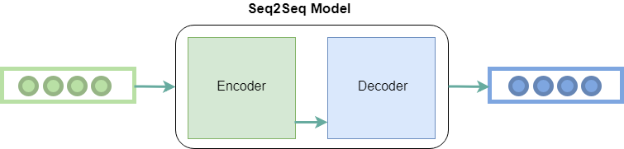
Architecture of Seq2Seq Models
Encoder:
Processes the input sequence (e.g., a sentence in the source language).
Produces a context vector (also called the hidden state or thought vector) that captures the input sequence’s entire meaning.
This is typically achieved by passing the sequence through an RNN, LSTM, or GRU.
Decoder:
Takes the context vector generated by the encoder as input.
Produces the output sequence (e.g., a sentence in the target language).
The decoder generates the output one step at a time, relying on the previously generated tokens and the context vector.
Training: During training, the model learns to map input sequences to output sequences.

Slide 71
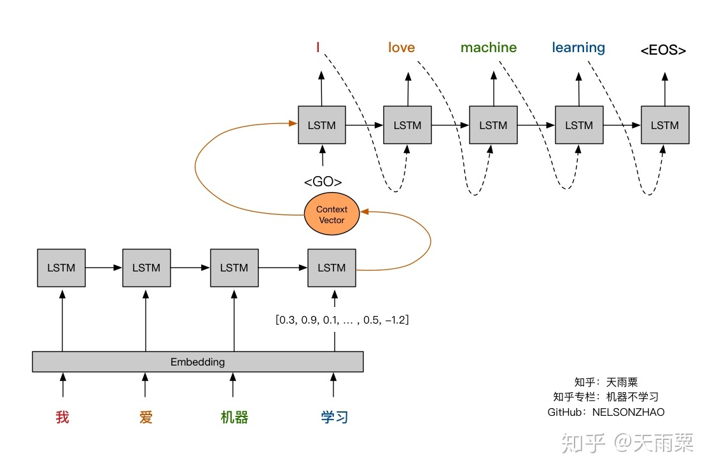
Seq2Seq Models

Slide 72
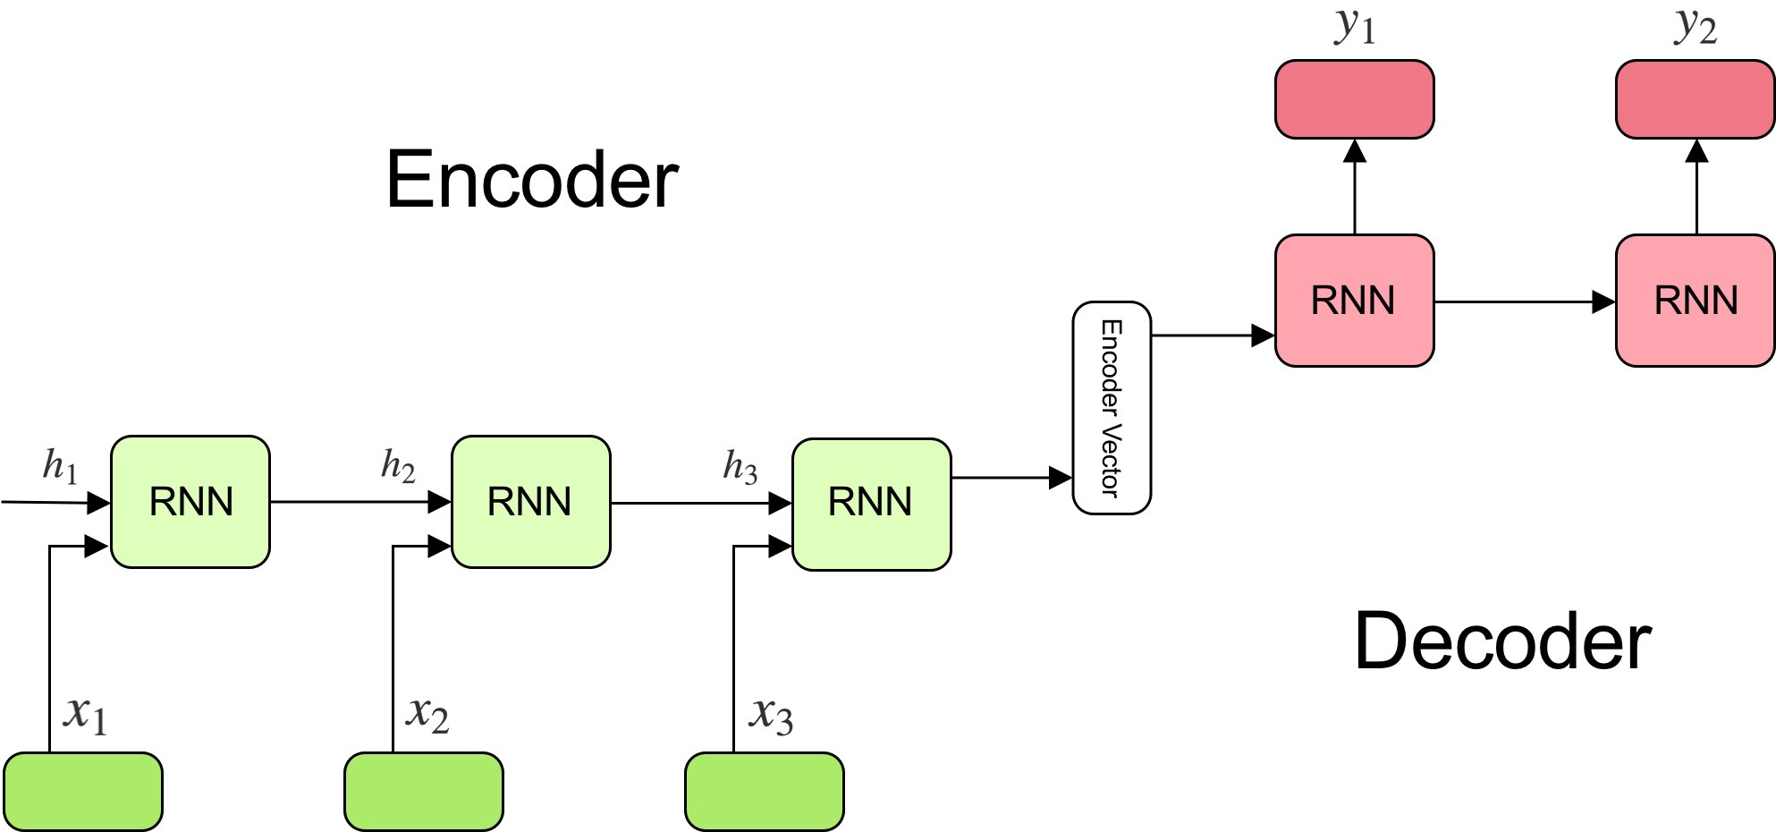
Seq2Seq Models

Slide 73
Flow of Data in Seq2Seq Models
Input to Encoder:
The input sequence is passed to the encoder in a step-by-step manner (e.g., words in a sentence or frames in speech).
The hidden state of the encoder RNN is updated at each step based on the current input and the previous hidden state.
Context Vector (Hidden State):
Once the entire input sequence is processed, the final hidden state of the encoder acts as the context vector.
This vector summarizes all the information from the input sequence.
Input to Decoder:
The decoder takes the context vector as the initial hidden state.
At each time step, the decoder predicts the next token in the output sequence.
The predicted token at one step is fed as input to the decoder at the next step (unless teacher forcing is applied).
Output Sequence:
The process continues until the decoder outputs the end-of-sequence token or until the sequence reaches a predefined maximum length.

Slide 74
Sequence-to-Sequence Models
Applications:
Neural Machine Translation (NMT): Used for translating text from one language to another.
Text Summarization: Converting long articles into shorter summaries.
Chatbots: Used in conversational AI to generate responses based on user input.
Advantages:
Can handle variable-length input and output sequences.
Learns the mapping between sequences without the need for heavy hand-crafted rules.

Slide 75
Steps in Neural Machine Translation:
Input Sequence: The source language sentence is fed into the encoder.
Encoding: The encoder processes the input sequence, updating its hidden state at each step, and finally produces a context vector that represents the entire input sequence.
Decoding: The decoder uses the context vector to generate the translated sentence in the target language.

Slide 76
How LSTM Fits into Seq2Seq Models?
Encoder with LSTM: In a Seq2Seq model, the encoder can be an LSTM instead of a standard RNN. This allows the encoder to more effectively capture and compress the information from a long input sequence into the context vector.
Decoder with LSTM: Similarly, the decoder can also be an LSTM. When generating the output sequence, the LSTM’s ability to remember important information from earlier in the sequence (e.g., the context vector from the encoder) helps produce more accurate translations or sequence predictions.

Slide 77
Attention Mechanism
Purpose: The attention mechanism addresses some limitations of traditional RNNs and LSTMs, particularly in sequence-to-sequence tasks. It allows models to focus on different parts of the input sequence when generating each element of the output sequence.
How It Works:
Contextual Focus: Instead of relying solely on the final hidden state of an RNN or LSTM to represent the entire input sequence, the attention mechanism enables the model to weigh the importance of different parts of the input sequence dynamically.
Alignment: For each output token, attention calculates a weighted sum of the encoder's hidden states, where the weights represent the importance or alignment of each input token relative to the current output token.
Example: In machine translation, when translating a sentence, the attention mechanism helps the model focus on the relevant words in the input sentence for each word in the output sentence.

Slide 78
How Attention Works:
At each decoding step, the decoder generates an attention weight for each word in the input sequence.
These weights determine how much focus the decoder should place on each word in the input sequence when generating the next word in the output sequence.
The context vector is dynamically generated for each output word based on these attention weights, allowing the model to attend to different parts of the input sequence.
Advantages of Attention:
Improved translation quality, especially for long sentences.
The model can handle longer input sequences more effectively by attending to relevant parts of the input.

Slide 79
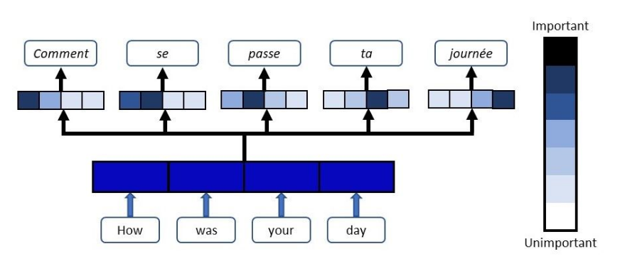
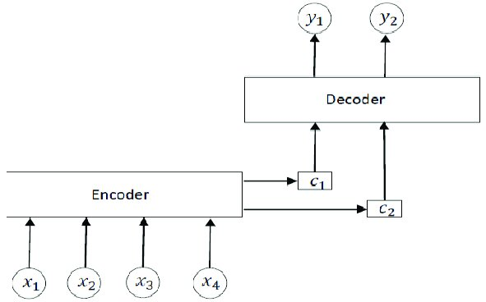
Attention Mechanism Architecture
https://www.scaler.com/topics/deep-learning/attention-mechanism-deep-learning/
https://www.researchgate.net/publication/342542123_Text_Sentiment_Orientation_Analysis_Based_on_Multi-Channel_CNN_and_Bidirectional_GRU_With_Attention_Mechanism

Slide 80
Transformer Model
The Transformer model, introduced by Vaswani et al. in 2017, revolutionized NMT by entirely eliminating RNNs and using only the attention mechanism.
Transformers rely on self-attention mechanisms to process entire sentences in parallel, significantly improving training efficiency and translation accuracy.
Self-Attention: In a transformer, each word in a sentence is compared with every other word to determine their relevance, which is then used to generate an output sequence. This allows the model to capture complex dependencies regardless of their distance in the sequence.
Architecture: The Transformer model uses multiple layers of self-attention and feedforward neural networks, organized into an encoder-decoder structure similar to Seq2Seq models but with parallel processing capabilities.
Advantages:
Faster training due to parallelism.
Better performance on long sequences.
The ability to capture complex relationships between words.

Slide 81
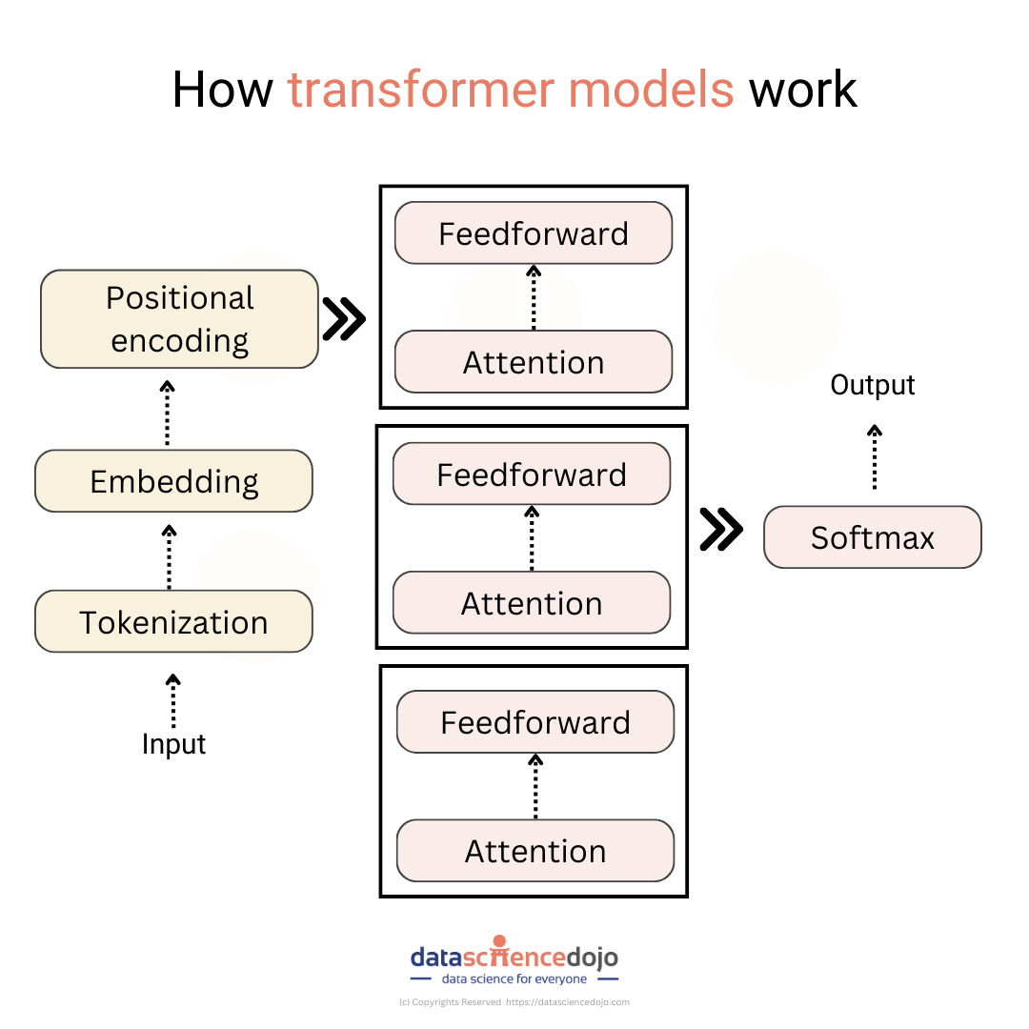
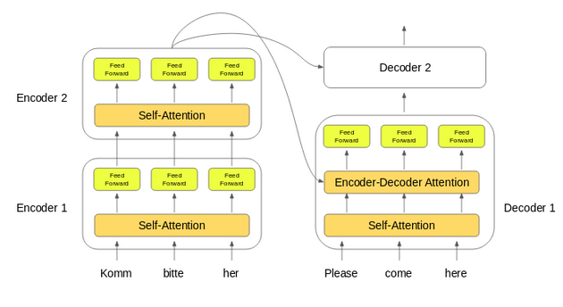
Transformer Architecture

Slide 82
How Transformers Work?
Self-Attention: Transformers use self-attention mechanisms to process sequences in parallel rather than sequentially. This allows the model to weigh the importance of each token in a sequence relative to all other tokens.
Multi-Head Attention: This technique allows the model to focus on different parts of the input sequence simultaneously, capturing various aspects of the relationships between tokens.
Positional Encoding: Since transformers do not inherently capture the order of tokens like RNNs, positional encoding is added to input embeddings to provide information about the position of tokens in the sequence.
Components:
Encoder: Processes the input sequence and generates representations.
Decoder: Generates the output sequence from the encoded representations, using attention to focus on relevant parts of the input sequence.

Slide 83
Summary – Translation Models
Seq2Seq Models:
Role: Framework for tasks where both input and output are sequences.
Usage: Can be enhanced with attention mechanisms or replaced by transformers for improved performance.
Attention Mechanism:
Role: Enhances Seq2Seq models by allowing dynamic focus on different parts of the input sequence.
Usage: Used in conjunction with RNNs or LSTMs to improve performance in sequence-to-sequence tasks.
Transformers:
Role: A novel architecture that relies on self-attention mechanisms to process sequences in parallel.
Usage: Replaces traditional RNN-based Seq2Seq models with a more efficient and scalable approach, particularly effective for long-range dependencies.
Attention mechanisms and transformers represent advancements in deep learning that address the limitations of traditional RNN-based Seq2Seq models, particularly in handling long-range dependencies and improving training efficiency.

Slide 84
Conclusion
Markov chains offer a simple yet foundational approach to text generation
RNNs and their variants (LSTMs, GRUs) bring in the capability to handle more complex and longer sequences.
In translation, Seq2Seq models, enhanced by attention mechanisms, form the backbone of modern NMT, with the Transformer model leading to significant advancements in translation quality and speed.

